Slide 1
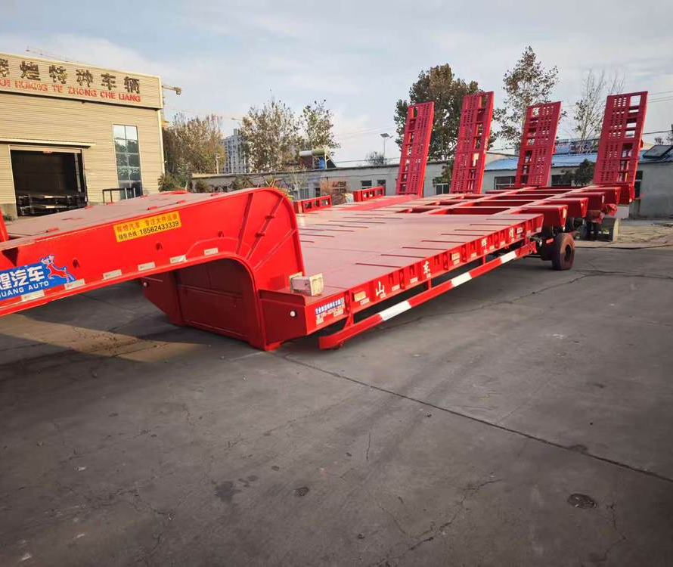
huihuang
01
huihuang
公司与产品介绍
山东辉煌专用车有限公司
中国山东 · 梁山
huihuang.yunwu.asia
Notes:
Company identity, establishment date and business scope: supplied business licence. Photographs: customer materials supplied 8–9 October 2026. White vehicle configuration: customer technical sheet, confirmed by the user to correspond to the white vehicle. Other model specifications: user-authorized reference configurations retained in the website data, sourced from https://www.yuhangauto.com/product/60-ton-lowbed-trailer-for-sale/ , https://www.yuhangauto.com/product/60t-rgn-lowboy-trailer-for-sale/ and https://www.yuhangauto.com/product/4-axle-detachable-lowboy-trailer-for-sale/ . Reference corporate brochure: Laizhou Shancha Machinery company PDF, used for section coverage only. No certifications, production volumes, export history, client cases or service guarantees from that company are attributed to huihuang.

Slide 2
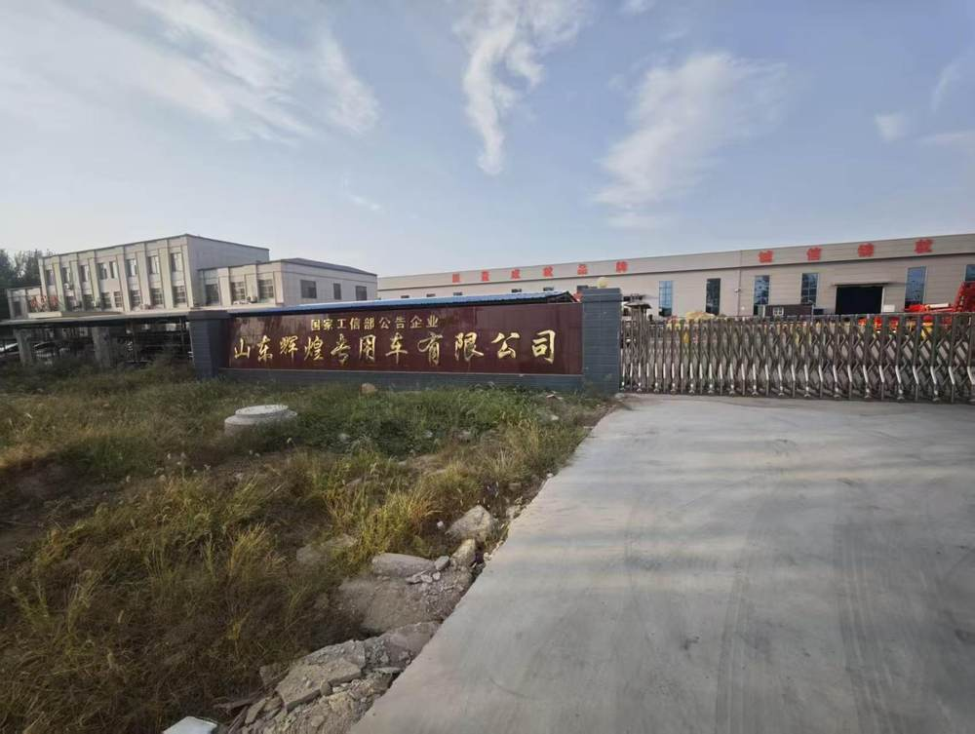
huihuang
02
公司概况
成立于2014年
位于山东梁山
山东辉煌专用车有限公司
成立于2014年7月22日。
公司位于山东省济宁市梁山县工业园区。业务涵盖半挂车、专用运输车辆及机械配件。
Notes:
Company identity, establishment date and business scope: supplied business licence. Photographs: customer materials supplied 8–9 October 2026. White vehicle configuration: customer technical sheet, confirmed by the user to correspond to the white vehicle. Other model specifications: user-authorized reference configurations retained in the website data, sourced from https://www.yuhangauto.com/product/60-ton-lowbed-trailer-for-sale/ , https://www.yuhangauto.com/product/60t-rgn-lowboy-trailer-for-sale/ and https://www.yuhangauto.com/product/4-axle-detachable-lowboy-trailer-for-sale/ . Reference corporate brochure: Laizhou Shancha Machinery company PDF, used for section coverage only. No certifications, production volumes, export history, client cases or service guarantees from that company are attributed to huihuang.

Slide 3
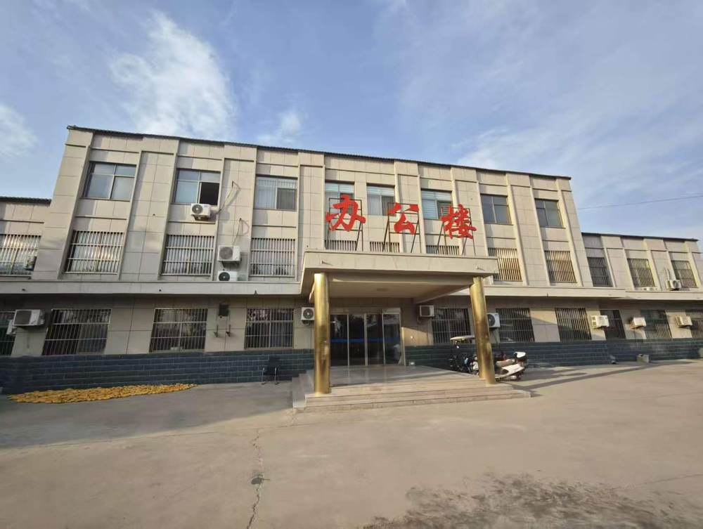
huihuang
03
业务范围
车辆产品与机械配件
半挂车
液压动力平板车
特种工程重载车
模块式组合液压挂车
半挂车设计与开发
机械配件制造与销售
Notes:
Company identity, establishment date and business scope: supplied business licence. Photographs: customer materials supplied 8–9 October 2026. White vehicle configuration: customer technical sheet, confirmed by the user to correspond to the white vehicle. Other model specifications: user-authorized reference configurations retained in the website data, sourced from https://www.yuhangauto.com/product/60-ton-lowbed-trailer-for-sale/ , https://www.yuhangauto.com/product/60t-rgn-lowboy-trailer-for-sale/ and https://www.yuhangauto.com/product/4-axle-detachable-lowboy-trailer-for-sale/ . Reference corporate brochure: Laizhou Shancha Machinery company PDF, used for section coverage only. No certifications, production volumes, export history, client cases or service guarantees from that company are attributed to huihuang.

Slide 4
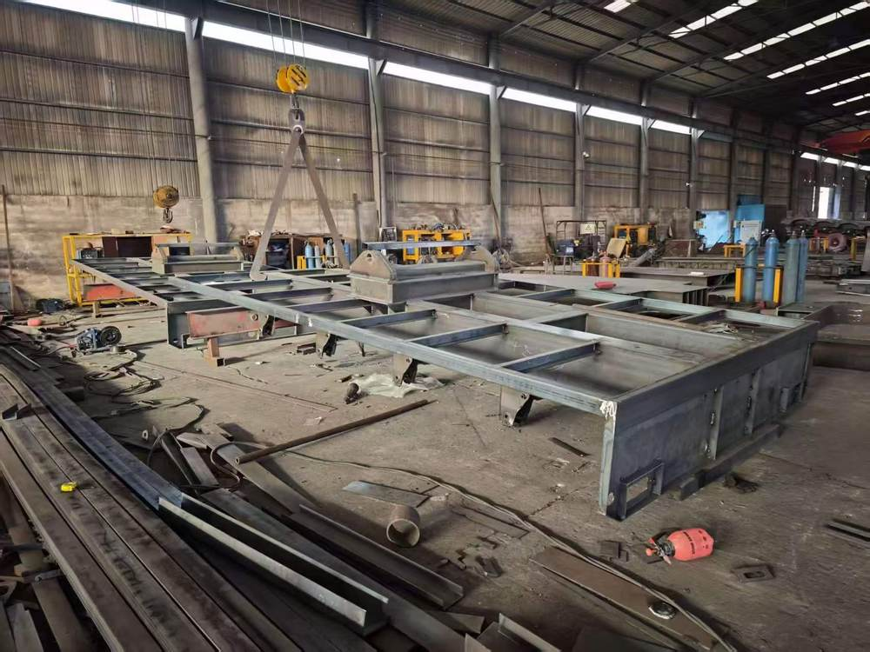
huihuang
04
车架制造实拍
车间中的挂车框架
照片展示挂车框架及制造区域。
沟通配置时，需要结合运输设备重量，确认车架尺寸与大梁参数。
Notes:
Company identity, establishment date and business scope: supplied business licence. Photographs: customer materials supplied 8–9 October 2026. White vehicle configuration: customer technical sheet, confirmed by the user to correspond to the white vehicle. Other model specifications: user-authorized reference configurations retained in the website data, sourced from https://www.yuhangauto.com/product/60-ton-lowbed-trailer-for-sale/ , https://www.yuhangauto.com/product/60t-rgn-lowboy-trailer-for-sale/ and https://www.yuhangauto.com/product/4-axle-detachable-lowboy-trailer-for-sale/ . Reference corporate brochure: Laizhou Shancha Machinery company PDF, used for section coverage only. No certifications, production volumes, export history, client cases or service guarantees from that company are attributed to huihuang.

Slide 5
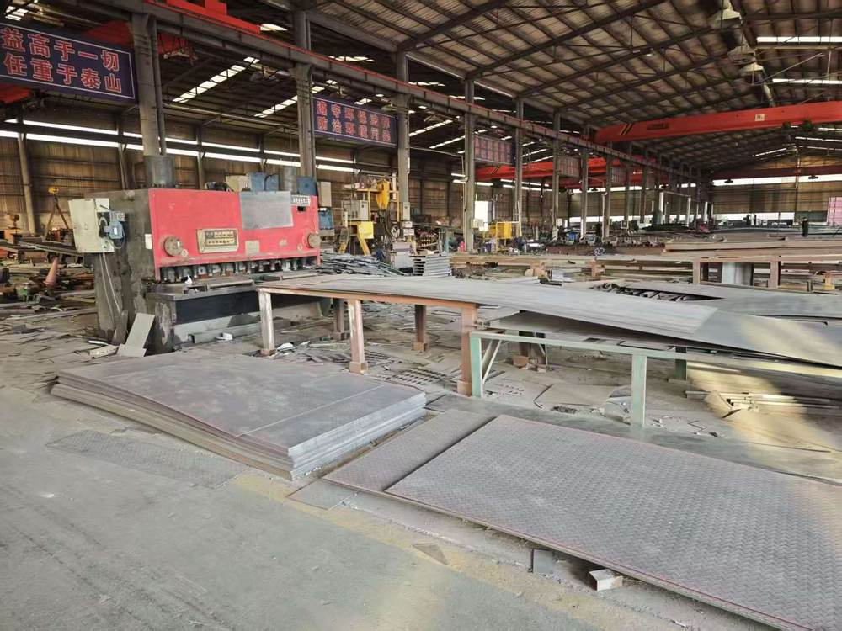
huihuang
05
车间设备实拍
设备与制造作业
工厂设备与制造作业实拍。
车辆结构、货台形式及配件选择，需结合具体配置进行沟通。
Notes:
Company identity, establishment date and business scope: supplied business licence. Photographs: customer materials supplied 8–9 October 2026. White vehicle configuration: customer technical sheet, confirmed by the user to correspond to the white vehicle. Other model specifications: user-authorized reference configurations retained in the website data, sourced from https://www.yuhangauto.com/product/60-ton-lowbed-trailer-for-sale/ , https://www.yuhangauto.com/product/60t-rgn-lowboy-trailer-for-sale/ and https://www.yuhangauto.com/product/4-axle-detachable-lowboy-trailer-for-sale/ . Reference corporate brochure: Laizhou Shancha Machinery company PDF, used for section coverage only. No certifications, production volumes, export history, client cases or service guarantees from that company are attributed to huihuang.

Slide 6
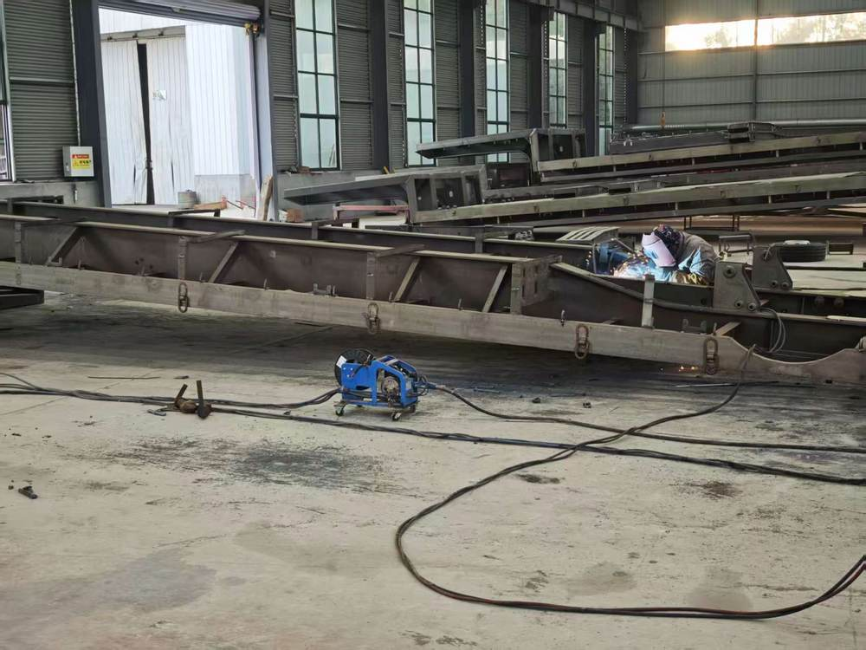
huihuang
06
挂车组装实拍
车架与组装作业
工厂照片展示车架与组装作业。
后续白色车配置页列出了悬架、车轮、支腿与爬梯等详细配置。
Notes:
Company identity, establishment date and business scope: supplied business licence. Photographs: customer materials supplied 8–9 October 2026. White vehicle configuration: customer technical sheet, confirmed by the user to correspond to the white vehicle. Other model specifications: user-authorized reference configurations retained in the website data, sourced from https://www.yuhangauto.com/product/60-ton-lowbed-trailer-for-sale/ , https://www.yuhangauto.com/product/60t-rgn-lowboy-trailer-for-sale/ and https://www.yuhangauto.com/product/4-axle-detachable-lowboy-trailer-for-sale/ . Reference corporate brochure: Laizhou Shancha Machinery company PDF, used for section coverage only. No certifications, production volumes, export history, client cases or service guarantees from that company are attributed to huihuang.

Slide 7
huihuang
07
产品范围与选型
车辆配置 | 现有资料 | 选型重点
14米四轴白色挂车 | 20项客户提供配置 | 整车尺寸与配件配置
低平板半挂车 | 60吨参考配置 | 货台尺寸与装载方式
鹅颈式低平板 | 60吨参考配置 | 车轴布局与装载空间
重载低平板 | 100吨参考配置 | 设备尺寸与载重要求
多轴低平板 | 具体配置需沟通 | 车轴组合与平台尺寸
参考载重用于选型沟通，具体订单配置需与辉煌确认。
Notes:
Company identity, establishment date and business scope: supplied business licence. Photographs: customer materials supplied 8–9 October 2026. White vehicle configuration: customer technical sheet, confirmed by the user to correspond to the white vehicle. Other model specifications: user-authorized reference configurations retained in the website data, sourced from https://www.yuhangauto.com/product/60-ton-lowbed-trailer-for-sale/ , https://www.yuhangauto.com/product/60t-rgn-lowboy-trailer-for-sale/ and https://www.yuhangauto.com/product/4-axle-detachable-lowboy-trailer-for-sale/ . Reference corporate brochure: Laizhou Shancha Machinery company PDF, used for section coverage only. No certifications, production volumes, export history, client cases or service guarantees from that company are attributed to huihuang.

Slide 8
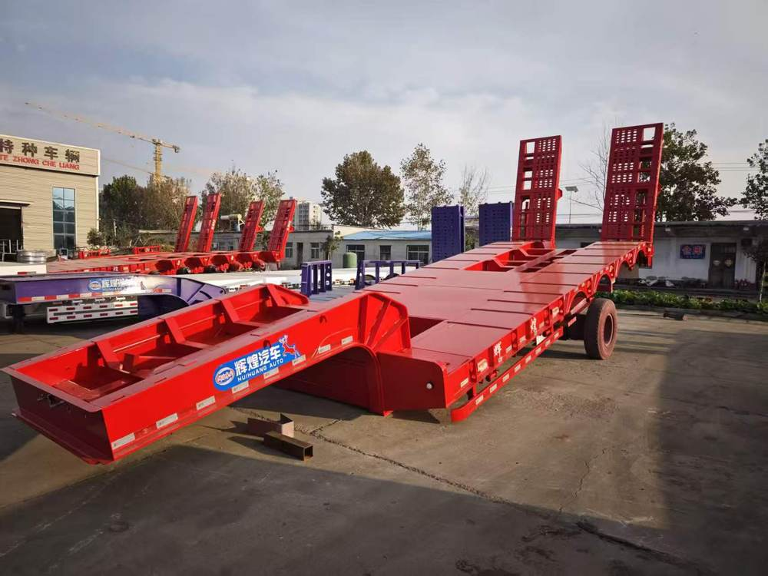
huihuang
08
低平板半挂车
配置项目 | 详细配置
载重 | 60 吨
外形尺寸 | 13,000 × 3,000 × 3,400 mm
主梁材质 | Q345B 钢
悬挂 | 机械悬挂
装载爬梯 | 弹簧爬梯
ABS | 可选
照片为客户提供的挂车实拍。表内参数为选型参考配置。
最终参数以选定配置及订单确认内容为准。
Notes:
Company identity, establishment date and business scope: supplied business licence. Photographs: customer materials supplied 8–9 October 2026. White vehicle configuration: customer technical sheet, confirmed by the user to correspond to the white vehicle. Other model specifications: user-authorized reference configurations retained in the website data, sourced from https://www.yuhangauto.com/product/60-ton-lowbed-trailer-for-sale/ , https://www.yuhangauto.com/product/60t-rgn-lowboy-trailer-for-sale/ and https://www.yuhangauto.com/product/4-axle-detachable-lowboy-trailer-for-sale/ . Reference corporate brochure: Laizhou Shancha Machinery company PDF, used for section coverage only. No certifications, production volumes, export history, client cases or service guarantees from that company are attributed to huihuang.

Slide 9
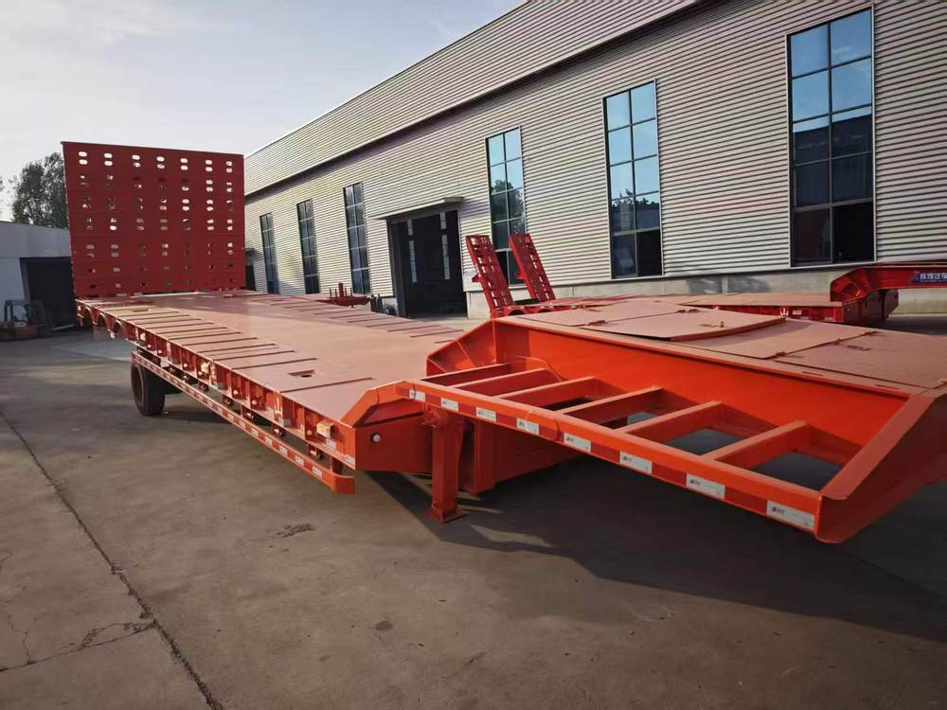
huihuang
09
鹅颈式低平板挂车
配置项目 | 详细配置
载重 | 60 吨
外形尺寸 | 15,800 × 3,000 × 2,200 mm
车轴组合 | 3 轴
悬挂 | 重载机械悬挂
电气系统 | 24 V，LED 灯
主梁材质 | Q345B 钢
照片为客户提供的挂车实拍。表内参数为选型参考配置。
最终参数以选定配置及订单确认内容为准。
Notes:
Company identity, establishment date and business scope: supplied business licence. Photographs: customer materials supplied 8–9 October 2026. White vehicle configuration: customer technical sheet, confirmed by the user to correspond to the white vehicle. Other model specifications: user-authorized reference configurations retained in the website data, sourced from https://www.yuhangauto.com/product/60-ton-lowbed-trailer-for-sale/ , https://www.yuhangauto.com/product/60t-rgn-lowboy-trailer-for-sale/ and https://www.yuhangauto.com/product/4-axle-detachable-lowboy-trailer-for-sale/ . Reference corporate brochure: Laizhou Shancha Machinery company PDF, used for section coverage only. No certifications, production volumes, export history, client cases or service guarantees from that company are attributed to huihuang.

Slide 10
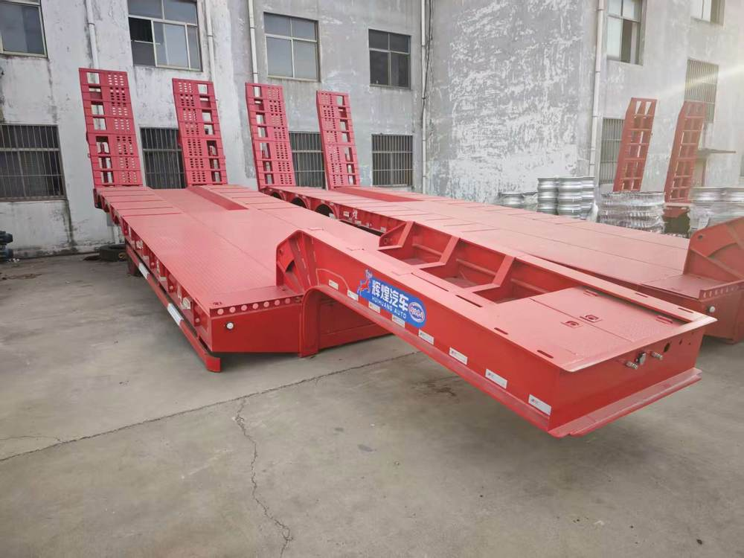
huihuang
10
重载低平板挂车
配置项目 | 详细配置
载重 | 100 吨
外形尺寸 | 17,000 × 3,500 × 2,500 mm
车轴组合 | 4 轴
轮胎配置 | 16 × 12R22.5
悬挂 | 机械悬挂
工具箱 | 1 套
照片为客户提供的挂车实拍。表内参数为选型参考配置。
最终参数以选定配置及订单确认内容为准。
Notes:
Company identity, establishment date and business scope: supplied business licence. Photographs: customer materials supplied 8–9 October 2026. White vehicle configuration: customer technical sheet, confirmed by the user to correspond to the white vehicle. Other model specifications: user-authorized reference configurations retained in the website data, sourced from https://www.yuhangauto.com/product/60-ton-lowbed-trailer-for-sale/ , https://www.yuhangauto.com/product/60t-rgn-lowboy-trailer-for-sale/ and https://www.yuhangauto.com/product/4-axle-detachable-lowboy-trailer-for-sale/ . Reference corporate brochure: Laizhou Shancha Machinery company PDF, used for section coverage only. No certifications, production volumes, export history, client cases or service guarantees from that company are attributed to huihuang.

Slide 11
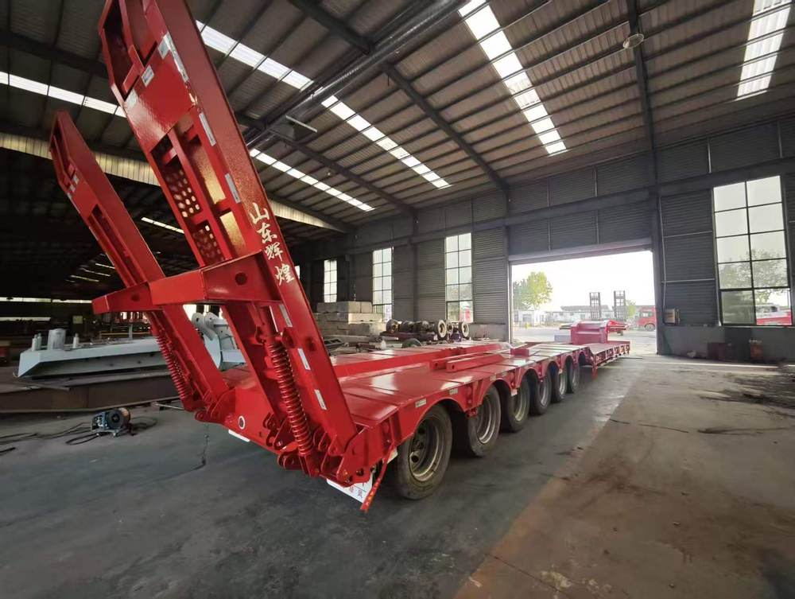
huihuang
11
多轴低平板挂车
配置项目 | 详细配置
车型 | 多轴低平板
载重 | 与团队确认
平台尺寸 | 与团队确认
车轴组合 | 与团队确认
提供设备重量、尺寸与装载方式，沟通适用配置。
最终参数以选定配置及订单确认内容为准。
Notes:
Company identity, establishment date and business scope: supplied business licence. Photographs: customer materials supplied 8–9 October 2026. White vehicle configuration: customer technical sheet, confirmed by the user to correspond to the white vehicle. Other model specifications: user-authorized reference configurations retained in the website data, sourced from https://www.yuhangauto.com/product/60-ton-lowbed-trailer-for-sale/ , https://www.yuhangauto.com/product/60t-rgn-lowboy-trailer-for-sale/ and https://www.yuhangauto.com/product/4-axle-detachable-lowboy-trailer-for-sale/ . Reference corporate brochure: Laizhou Shancha Machinery company PDF, used for section coverage only. No certifications, production volumes, export history, client cases or service guarantees from that company are attributed to huihuang.

Slide 12
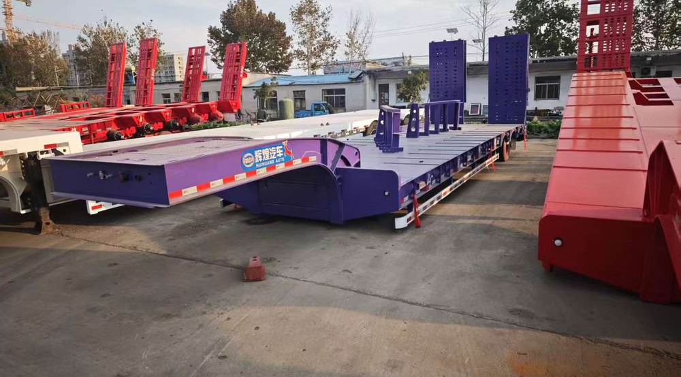
huihuang
12
挂车产品实拍
对照车辆布局
实拍照片展示不同车辆布局与车身颜色。
各车型的尺寸、载重及装载方式需单独确认。
Notes:
Company identity, establishment date and business scope: supplied business licence. Photographs: customer materials supplied 8–9 October 2026. White vehicle configuration: customer technical sheet, confirmed by the user to correspond to the white vehicle. Other model specifications: user-authorized reference configurations retained in the website data, sourced from https://www.yuhangauto.com/product/60-ton-lowbed-trailer-for-sale/ , https://www.yuhangauto.com/product/60t-rgn-lowboy-trailer-for-sale/ and https://www.yuhangauto.com/product/4-axle-detachable-lowboy-trailer-for-sale/ . Reference corporate brochure: Laizhou Shancha Machinery company PDF, used for section coverage only. No certifications, production volumes, export history, client cases or service guarantees from that company are attributed to huihuang.

Slide 13
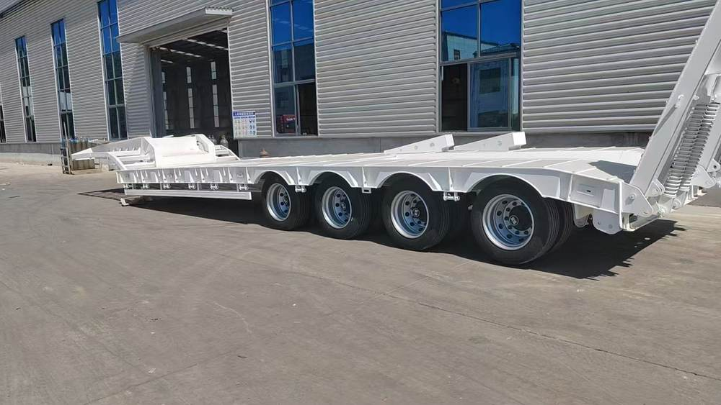
huihuang
13
14米四轴低平板半挂车
14 × 3.2 × 3.7 米
外形尺寸
四轴配置与纯平货台
白色车身
Notes:
Company identity, establishment date and business scope: supplied business licence. Photographs: customer materials supplied 8–9 October 2026. White vehicle configuration: customer technical sheet, confirmed by the user to correspond to the white vehicle. Other model specifications: user-authorized reference configurations retained in the website data, sourced from https://www.yuhangauto.com/product/60-ton-lowbed-trailer-for-sale/ , https://www.yuhangauto.com/product/60t-rgn-lowboy-trailer-for-sale/ and https://www.yuhangauto.com/product/4-axle-detachable-lowboy-trailer-for-sale/ . Reference corporate brochure: Laizhou Shancha Machinery company PDF, used for section coverage only. No certifications, production volumes, export history, client cases or service guarantees from that company are attributed to huihuang.

Slide 14
huihuang
14
尺寸与主体结构
配置项目 | 详细配置
外形尺寸 | 14,000 × 3,200 × 3,700 mm
车轴数量 | 4 根
颜色 | 白色
大梁高度 | 520 mm
上翼板厚度 | 16 mm
下翼板厚度 | 20 mm，下贴加固板条
立板厚度 | 12 mm
立板加固 | 加固
白色车配置依据客户提供的技术表整理。
Notes:
Company identity, establishment date and business scope: supplied business licence. Photographs: customer materials supplied 8–9 October 2026. White vehicle configuration: customer technical sheet, confirmed by the user to correspond to the white vehicle. Other model specifications: user-authorized reference configurations retained in the website data, sourced from https://www.yuhangauto.com/product/60-ton-lowbed-trailer-for-sale/ , https://www.yuhangauto.com/product/60t-rgn-lowboy-trailer-for-sale/ and https://www.yuhangauto.com/product/4-axle-detachable-lowboy-trailer-for-sale/ . Reference corporate brochure: Laizhou Shancha Machinery company PDF, used for section coverage only. No certifications, production volumes, export history, client cases or service guarantees from that company are attributed to huihuang.

Slide 15
huihuang
15
货台与行走机构
配置项目 | 详细配置
底板结构 | 高强底板，加三道筋
货台形式 | 货台面纯平，不做凹芯
轮胎规格 | 威山 295-60
轮胎数量 | 16 条
钢圈 | 厂配加厚，16 只
板簧 | 10 片加厚
悬架系统 | 加厚悬架
额定载重与轮胎完整规格需按具体订单确认。
Notes:
Company identity, establishment date and business scope: supplied business licence. Photographs: customer materials supplied 8–9 October 2026. White vehicle configuration: customer technical sheet, confirmed by the user to correspond to the white vehicle. Other model specifications: user-authorized reference configurations retained in the website data, sourced from https://www.yuhangauto.com/product/60-ton-lowbed-trailer-for-sale/ , https://www.yuhangauto.com/product/60t-rgn-lowboy-trailer-for-sale/ and https://www.yuhangauto.com/product/4-axle-detachable-lowboy-trailer-for-sale/ . Reference corporate brochure: Laizhou Shancha Machinery company PDF, used for section coverage only. No certifications, production volumes, export history, client cases or service guarantees from that company are attributed to huihuang.

Slide 16
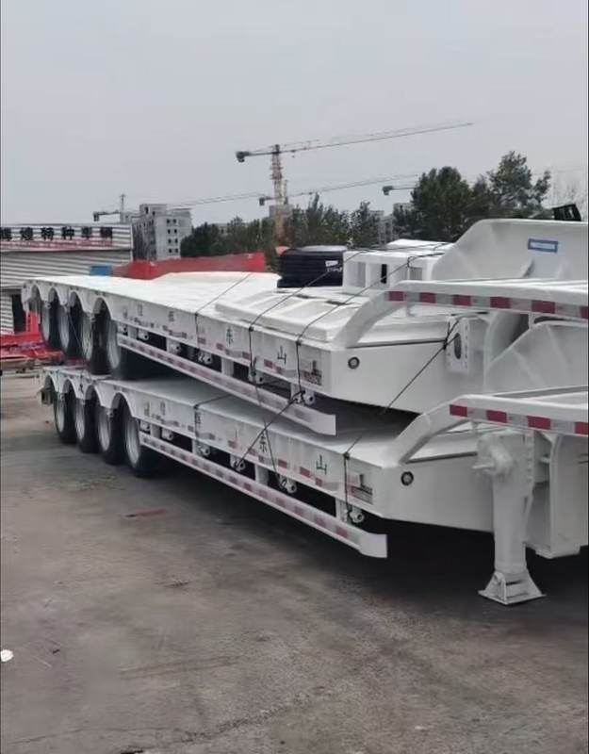
huihuang
16
装载与辅助配置
配置项目 | 详细配置
支腿 | 广东富华单动
爬梯 | 双宽爬梯，宽 950 mm
紧绳器 | 每侧 8 个
直钩 | 直钩加密加厚
制动阀 | 威伯科
客户配置列明广东富华支腿及威伯科制动阀。
Notes:
Company identity, establishment date and business scope: supplied business licence. Photographs: customer materials supplied 8–9 October 2026. White vehicle configuration: customer technical sheet, confirmed by the user to correspond to the white vehicle. Other model specifications: user-authorized reference configurations retained in the website data, sourced from https://www.yuhangauto.com/product/60-ton-lowbed-trailer-for-sale/ , https://www.yuhangauto.com/product/60t-rgn-lowboy-trailer-for-sale/ and https://www.yuhangauto.com/product/4-axle-detachable-lowboy-trailer-for-sale/ . Reference corporate brochure: Laizhou Shancha Machinery company PDF, used for section coverage only. No certifications, production volumes, export history, client cases or service guarantees from that company are attributed to huihuang.

Slide 17
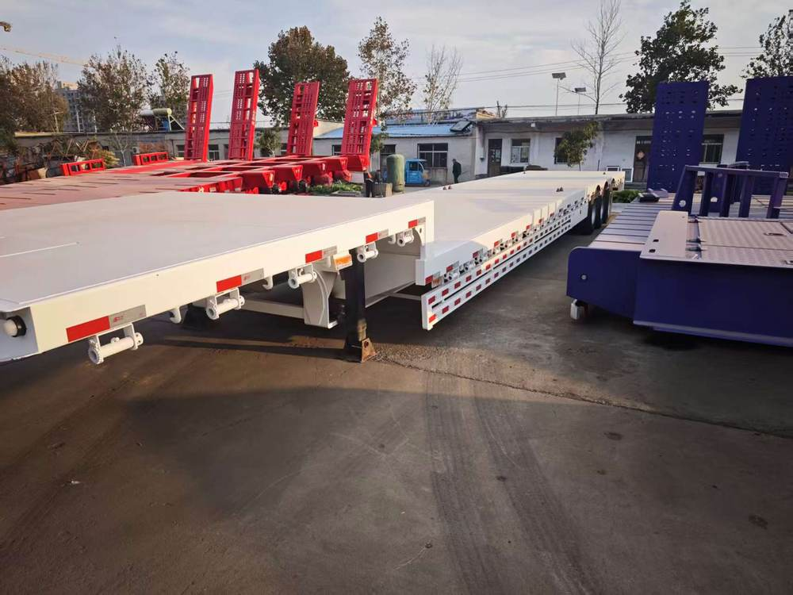
huihuang
17
大梁与货台选型
结合运输需求
确认主体结构
白色车技术表列明520 mm大梁，16 mm上翼板、20 mm下翼板与12 mm立板。
货台为纯平形式，不做凹芯。
其他车辆的大梁及货台参数需分别确认。
Notes:
Company identity, establishment date and business scope: supplied business licence. Photographs: customer materials supplied 8–9 October 2026. White vehicle configuration: customer technical sheet, confirmed by the user to correspond to the white vehicle. Other model specifications: user-authorized reference configurations retained in the website data, sourced from https://www.yuhangauto.com/product/60-ton-lowbed-trailer-for-sale/ , https://www.yuhangauto.com/product/60t-rgn-lowboy-trailer-for-sale/ and https://www.yuhangauto.com/product/4-axle-detachable-lowboy-trailer-for-sale/ . Reference corporate brochure: Laizhou Shancha Machinery company PDF, used for section coverage only. No certifications, production volumes, export history, client cases or service guarantees from that company are attributed to huihuang.

Slide 18
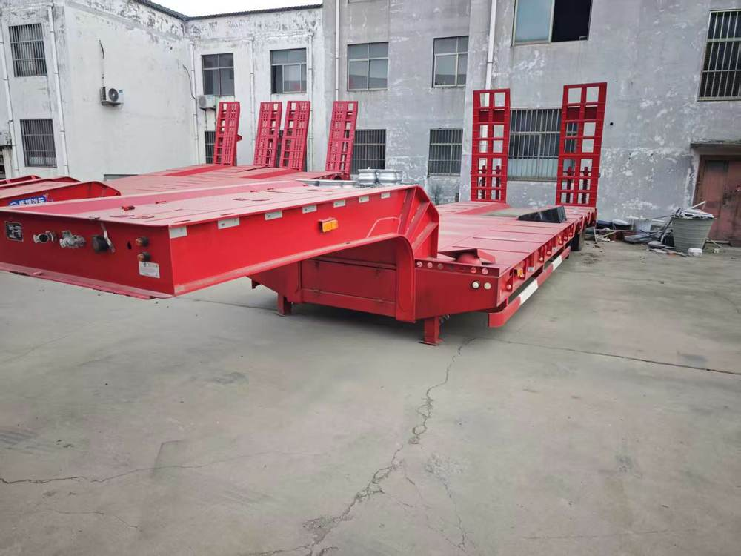
huihuang
18
装载方式选型
爬梯与装载空间
结合设备接近角、履带或车轮宽度，确认装载空间。
白色车技术表列明双宽爬梯，宽950 mm。
选型时确认爬梯尺寸与操作形式。
Notes:
Company identity, establishment date and business scope: supplied business licence. Photographs: customer materials supplied 8–9 October 2026. White vehicle configuration: customer technical sheet, confirmed by the user to correspond to the white vehicle. Other model specifications: user-authorized reference configurations retained in the website data, sourced from https://www.yuhangauto.com/product/60-ton-lowbed-trailer-for-sale/ , https://www.yuhangauto.com/product/60t-rgn-lowboy-trailer-for-sale/ and https://www.yuhangauto.com/product/4-axle-detachable-lowboy-trailer-for-sale/ . Reference corporate brochure: Laizhou Shancha Machinery company PDF, used for section coverage only. No certifications, production volumes, export history, client cases or service guarantees from that company are attributed to huihuang.

Slide 19
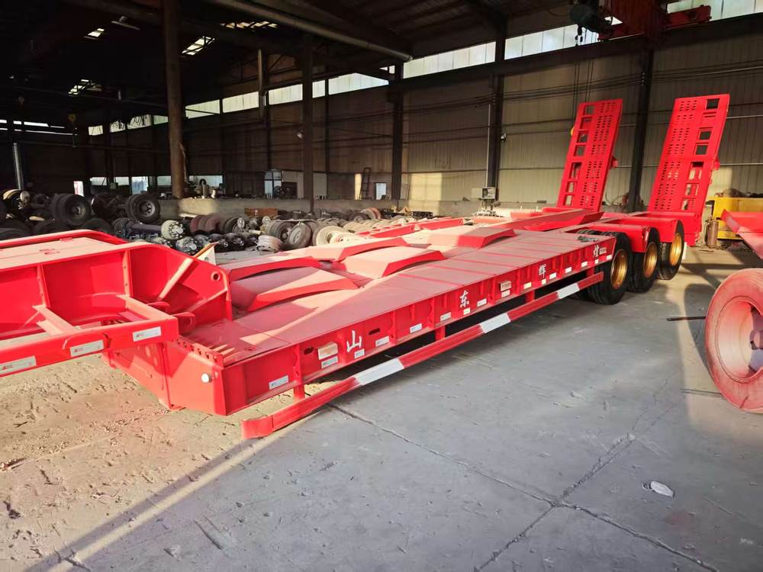
huihuang
19
配置沟通事项
车辆尺寸与配件选型
整车尺寸与可用货台空间
车轴、悬架、轮胎与板簧
支腿与装载爬梯
制动、灯具与钢圈
下单前以书面方式确认选定配置。
Notes:
Company identity, establishment date and business scope: supplied business licence. Photographs: customer materials supplied 8–9 October 2026. White vehicle configuration: customer technical sheet, confirmed by the user to correspond to the white vehicle. Other model specifications: user-authorized reference configurations retained in the website data, sourced from https://www.yuhangauto.com/product/60-ton-lowbed-trailer-for-sale/ , https://www.yuhangauto.com/product/60t-rgn-lowboy-trailer-for-sale/ and https://www.yuhangauto.com/product/4-axle-detachable-lowboy-trailer-for-sale/ . Reference corporate brochure: Laizhou Shancha Machinery company PDF, used for section coverage only. No certifications, production volumes, export history, client cases or service guarantees from that company are attributed to huihuang.

Slide 20
huihuang
20
询价所需信息
信息项目 | 需要提供的内容
运输设备 | 设备类型、型号与照片
重量与尺寸 | 设备重量、长宽高
装载方式 | 设备上下车方式与所需空间
使用条件 | 目的地、路线限制及当地要求
配置要求 | 车轴、货台、爬梯及指定配件
订单信息 | 数量、交付地点与期望时间
当地适用要求、运输安排与交付条款需另行确认。
Notes:
Company identity, establishment date and business scope: supplied business licence. Photographs: customer materials supplied 8–9 October 2026. White vehicle configuration: customer technical sheet, confirmed by the user to correspond to the white vehicle. Other model specifications: user-authorized reference configurations retained in the website data, sourced from https://www.yuhangauto.com/product/60-ton-lowbed-trailer-for-sale/ , https://www.yuhangauto.com/product/60t-rgn-lowboy-trailer-for-sale/ and https://www.yuhangauto.com/product/4-axle-detachable-lowboy-trailer-for-sale/ . Reference corporate brochure: Laizhou Shancha Machinery company PDF, used for section coverage only. No certifications, production volumes, export history, client cases or service guarantees from that company are attributed to huihuang.

Slide 21
huihuang
21
订单与服务沟通
配置确认
确认车辆尺寸、载重要求及配件清单，依据确定配置沟通报价。
交付与商务条款
按订单确认数量、交付地点、付款条款与交付时间。
服务与维护要求
下单前沟通保修、操作说明、维护资料及配件需求。
Notes:
Company identity, establishment date and business scope: supplied business licence. Photographs: customer materials supplied 8–9 October 2026. White vehicle configuration: customer technical sheet, confirmed by the user to correspond to the white vehicle. Other model specifications: user-authorized reference configurations retained in the website data, sourced from https://www.yuhangauto.com/product/60-ton-lowbed-trailer-for-sale/ , https://www.yuhangauto.com/product/60t-rgn-lowboy-trailer-for-sale/ and https://www.yuhangauto.com/product/4-axle-detachable-lowboy-trailer-for-sale/ . Reference corporate brochure: Laizhou Shancha Machinery company PDF, used for section coverage only. No certifications, production volumes, export history, client cases or service guarantees from that company are attributed to huihuang.

Slide 22
huihuang
22
联系辉煌
半挂车与专用车辆
+86 13684939429
gaoyangy14@gmail.com
WhatsApp +9875852376888
huihuang.yunwu.asia
山东省济宁市梁山县工业园区
Notes:
Company identity, establishment date and business scope: supplied business licence. Photographs: customer materials supplied 8–9 October 2026. White vehicle configuration: customer technical sheet, confirmed by the user to correspond to the white vehicle. Other model specifications: user-authorized reference configurations retained in the website data, sourced from https://www.yuhangauto.com/product/60-ton-lowbed-trailer-for-sale/ , https://www.yuhangauto.com/product/60t-rgn-lowboy-trailer-for-sale/ and https://www.yuhangauto.com/product/4-axle-detachable-lowboy-trailer-for-sale/ . Reference corporate brochure: Laizhou Shancha Machinery company PDF, used for section coverage only. No certifications, production volumes, export history, client cases or service guarantees from that company are attributed to huihuang.

