Slide 1
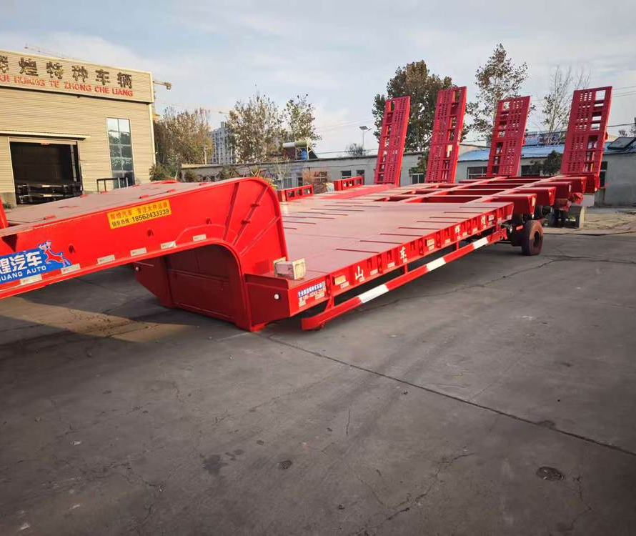
huihuang
01
huihuang
Company and
product profile
Semi-trailers and special vehicles
Liangshan, Shandong, China
huihuang.yunwu.asia
Notes:
Company identity, establishment date and business scope: supplied business licence. Photographs: customer materials supplied 8–9 October 2026. White vehicle configuration: customer technical sheet, confirmed by the user to correspond to the white vehicle. Other model specifications: user-authorized reference configurations retained in the website data, sourced from https://www.yuhangauto.com/product/60-ton-lowbed-trailer-for-sale/ , https://www.yuhangauto.com/product/60t-rgn-lowboy-trailer-for-sale/ and https://www.yuhangauto.com/product/4-axle-detachable-lowboy-trailer-for-sale/ . Reference corporate brochure: Laizhou Shancha Machinery company PDF, used for section coverage only. No certifications, production volumes, export history, client cases or service guarantees from that company are attributed to huihuang.

Slide 2
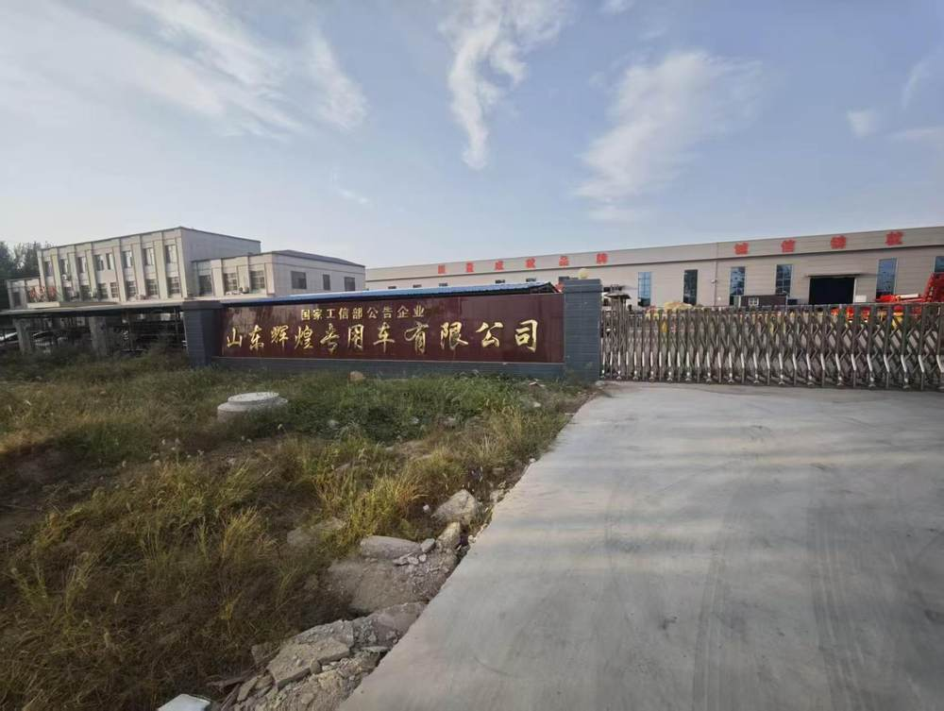
huihuang
02
Company overview
Established in 2014
Based in Liangshan
huihuang was established on 22 July 2014. The company is based in Liangshan County Industrial Park, Jining, Shandong.
Our business covers semi-trailers, special transport vehicles and mechanical parts.
Notes:
Company identity, establishment date and business scope: supplied business licence. Photographs: customer materials supplied 8–9 October 2026. White vehicle configuration: customer technical sheet, confirmed by the user to correspond to the white vehicle. Other model specifications: user-authorized reference configurations retained in the website data, sourced from https://www.yuhangauto.com/product/60-ton-lowbed-trailer-for-sale/ , https://www.yuhangauto.com/product/60t-rgn-lowboy-trailer-for-sale/ and https://www.yuhangauto.com/product/4-axle-detachable-lowboy-trailer-for-sale/ . Reference corporate brochure: Laizhou Shancha Machinery company PDF, used for section coverage only. No certifications, production volumes, export history, client cases or service guarantees from that company are attributed to huihuang.

Slide 3
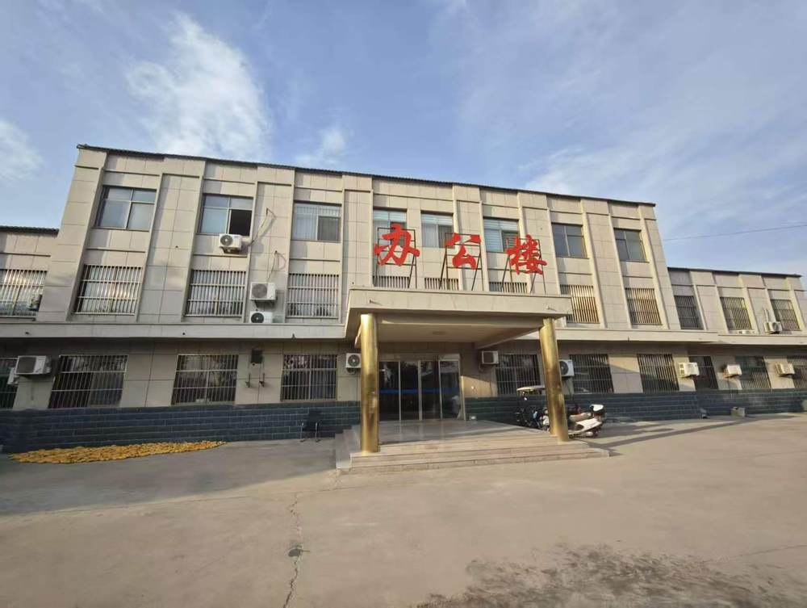
huihuang
03
Business scope
Vehicle products
and mechanical parts
Semi-trailers
Hydraulic flatbed trailers
Special engineering transport vehicles
Modular hydraulic trailers
Trailer design and development
Mechanical parts manufacturing and sales
Notes:
Company identity, establishment date and business scope: supplied business licence. Photographs: customer materials supplied 8–9 October 2026. White vehicle configuration: customer technical sheet, confirmed by the user to correspond to the white vehicle. Other model specifications: user-authorized reference configurations retained in the website data, sourced from https://www.yuhangauto.com/product/60-ton-lowbed-trailer-for-sale/ , https://www.yuhangauto.com/product/60t-rgn-lowboy-trailer-for-sale/ and https://www.yuhangauto.com/product/4-axle-detachable-lowboy-trailer-for-sale/ . Reference corporate brochure: Laizhou Shancha Machinery company PDF, used for section coverage only. No certifications, production volumes, export history, client cases or service guarantees from that company are attributed to huihuang.

Slide 4
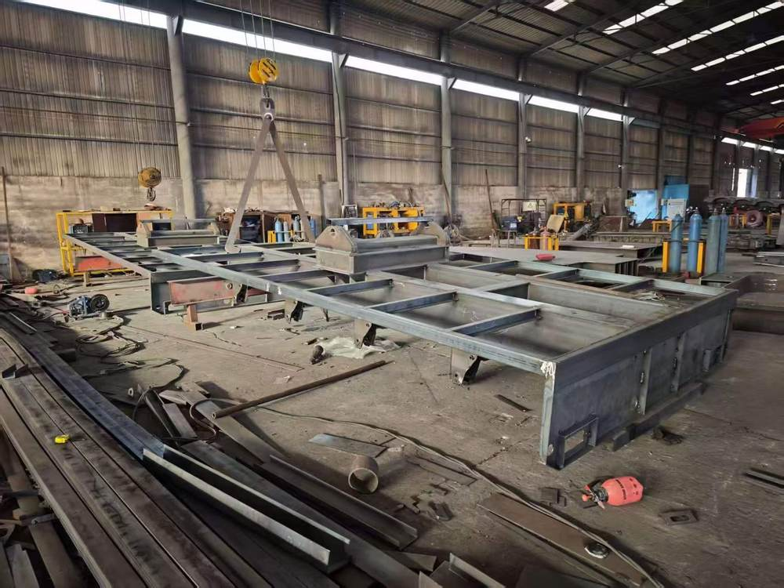
huihuang
04
Frame fabrication
Vehicle frames
in the workshop
The photograph shows vehicle frames and the fabrication area.
When discussing a configuration, confirm the frame dimensions and main beam specifications together with the required load.
Notes:
Company identity, establishment date and business scope: supplied business licence. Photographs: customer materials supplied 8–9 October 2026. White vehicle configuration: customer technical sheet, confirmed by the user to correspond to the white vehicle. Other model specifications: user-authorized reference configurations retained in the website data, sourced from https://www.yuhangauto.com/product/60-ton-lowbed-trailer-for-sale/ , https://www.yuhangauto.com/product/60t-rgn-lowboy-trailer-for-sale/ and https://www.yuhangauto.com/product/4-axle-detachable-lowboy-trailer-for-sale/ . Reference corporate brochure: Laizhou Shancha Machinery company PDF, used for section coverage only. No certifications, production volumes, export history, client cases or service guarantees from that company are attributed to huihuang.

Slide 5
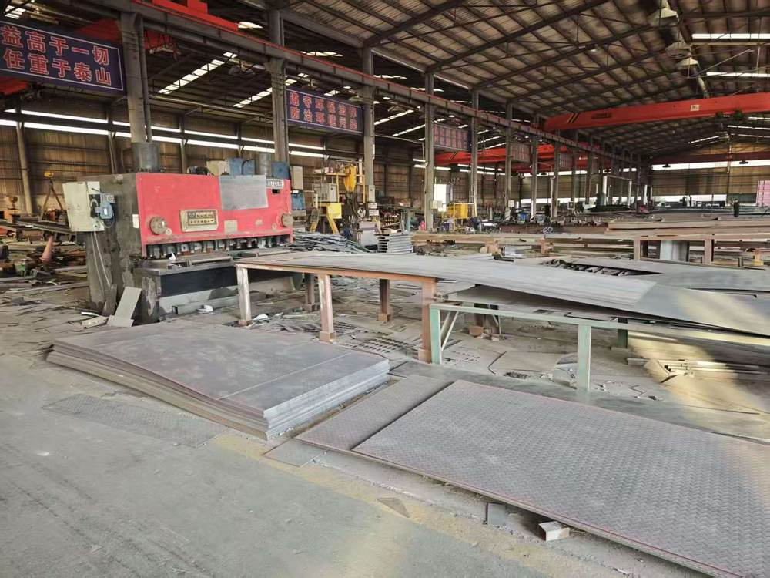
huihuang
05
Workshop equipment
Equipment and
fabrication work
A view of the equipment and fabrication work at the factory.
The trailer structure, deck construction and component selection form part of the configuration discussion.
Notes:
Company identity, establishment date and business scope: supplied business licence. Photographs: customer materials supplied 8–9 October 2026. White vehicle configuration: customer technical sheet, confirmed by the user to correspond to the white vehicle. Other model specifications: user-authorized reference configurations retained in the website data, sourced from https://www.yuhangauto.com/product/60-ton-lowbed-trailer-for-sale/ , https://www.yuhangauto.com/product/60t-rgn-lowboy-trailer-for-sale/ and https://www.yuhangauto.com/product/4-axle-detachable-lowboy-trailer-for-sale/ . Reference corporate brochure: Laizhou Shancha Machinery company PDF, used for section coverage only. No certifications, production volumes, export history, client cases or service guarantees from that company are attributed to huihuang.

Slide 6
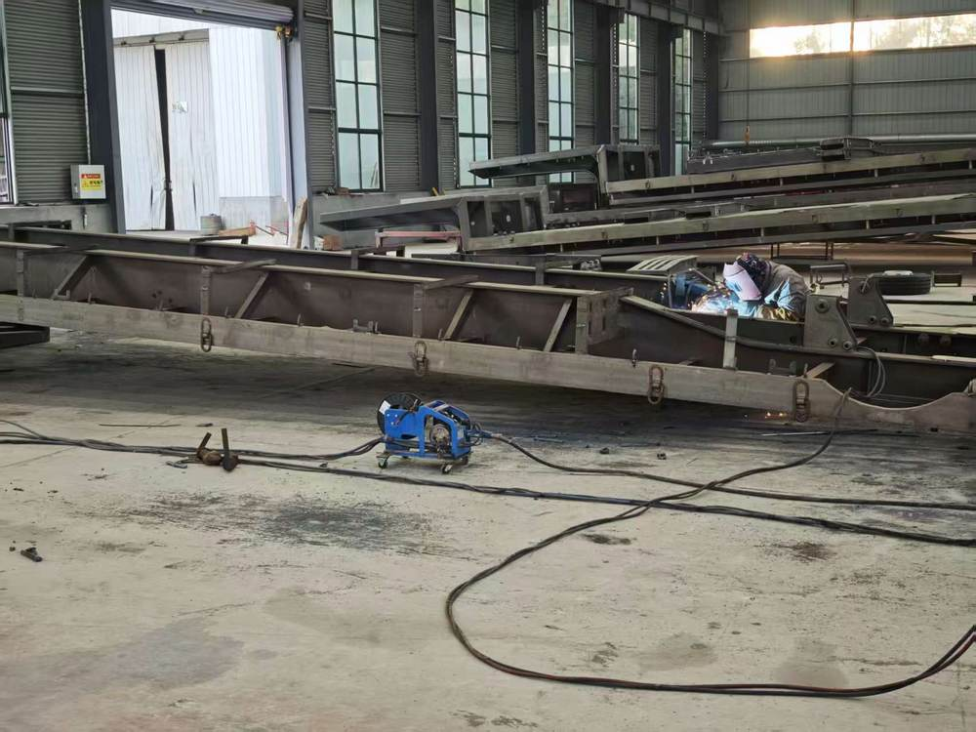
huihuang
06
Trailer assembly
Frames and
assembly work
Factory photographs show frames during assembly.
The white trailer configuration later in this profile lists the specified suspension, wheels, landing gear and loading ramps.
Notes:
Company identity, establishment date and business scope: supplied business licence. Photographs: customer materials supplied 8–9 October 2026. White vehicle configuration: customer technical sheet, confirmed by the user to correspond to the white vehicle. Other model specifications: user-authorized reference configurations retained in the website data, sourced from https://www.yuhangauto.com/product/60-ton-lowbed-trailer-for-sale/ , https://www.yuhangauto.com/product/60t-rgn-lowboy-trailer-for-sale/ and https://www.yuhangauto.com/product/4-axle-detachable-lowboy-trailer-for-sale/ . Reference corporate brochure: Laizhou Shancha Machinery company PDF, used for section coverage only. No certifications, production volumes, export history, client cases or service guarantees from that company are attributed to huihuang.

Slide 7
huihuang
07
Trailer range and selection
Configuration | Information available | Selection focus
14 m four-axle white trailer | 20 customer-supplied specifications | Overall size and component details
Lowbed semi-trailer | 60 t reference configuration | Deck size and loading method
Gooseneck lowbed | 60 t reference configuration | Axle layout and loading arrangement
Heavy-duty lowbed | 100 t reference configuration | Machinery size and load requirements
Multi-axle lowbed | Configuration to discuss | Axle arrangement and platform size
Reference ratings are selection guides. Confirm the ordered configuration with huihuang.
Notes:
Company identity, establishment date and business scope: supplied business licence. Photographs: customer materials supplied 8–9 October 2026. White vehicle configuration: customer technical sheet, confirmed by the user to correspond to the white vehicle. Other model specifications: user-authorized reference configurations retained in the website data, sourced from https://www.yuhangauto.com/product/60-ton-lowbed-trailer-for-sale/ , https://www.yuhangauto.com/product/60t-rgn-lowboy-trailer-for-sale/ and https://www.yuhangauto.com/product/4-axle-detachable-lowboy-trailer-for-sale/ . Reference corporate brochure: Laizhou Shancha Machinery company PDF, used for section coverage only. No certifications, production volumes, export history, client cases or service guarantees from that company are attributed to huihuang.

Slide 8
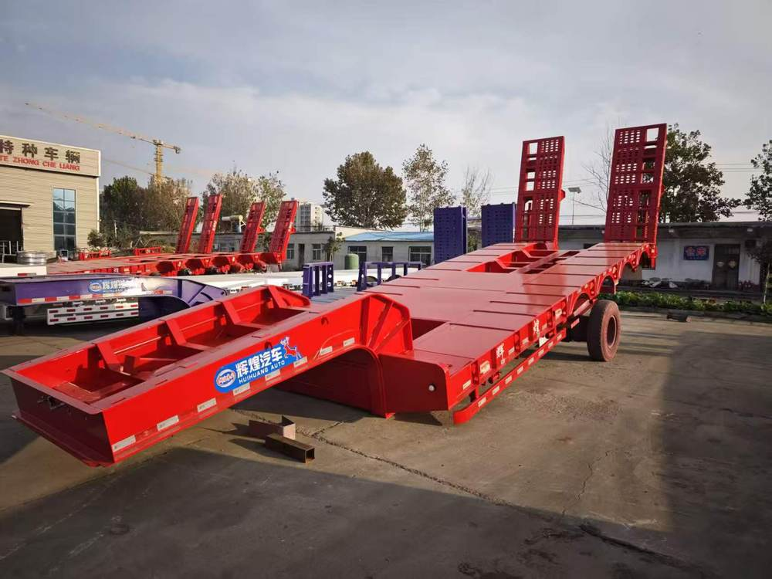
huihuang
08
Lowbed Semi Trailer
Specification | Details
payload | 60 t
dimensions | 13,000 × 3,000 × 3,400 mm
Main beam material | Q345B steel
Suspension | Mechanical suspension
Loading ramp | Spring ramp
ABS | Optional
The photograph shows a supplied trailer. The table gives a reference configuration for selection.
Final specifications depend on the selected configuration and order confirmation.
Notes:
Company identity, establishment date and business scope: supplied business licence. Photographs: customer materials supplied 8–9 October 2026. White vehicle configuration: customer technical sheet, confirmed by the user to correspond to the white vehicle. Other model specifications: user-authorized reference configurations retained in the website data, sourced from https://www.yuhangauto.com/product/60-ton-lowbed-trailer-for-sale/ , https://www.yuhangauto.com/product/60t-rgn-lowboy-trailer-for-sale/ and https://www.yuhangauto.com/product/4-axle-detachable-lowboy-trailer-for-sale/ . Reference corporate brochure: Laizhou Shancha Machinery company PDF, used for section coverage only. No certifications, production volumes, export history, client cases or service guarantees from that company are attributed to huihuang.

Slide 9
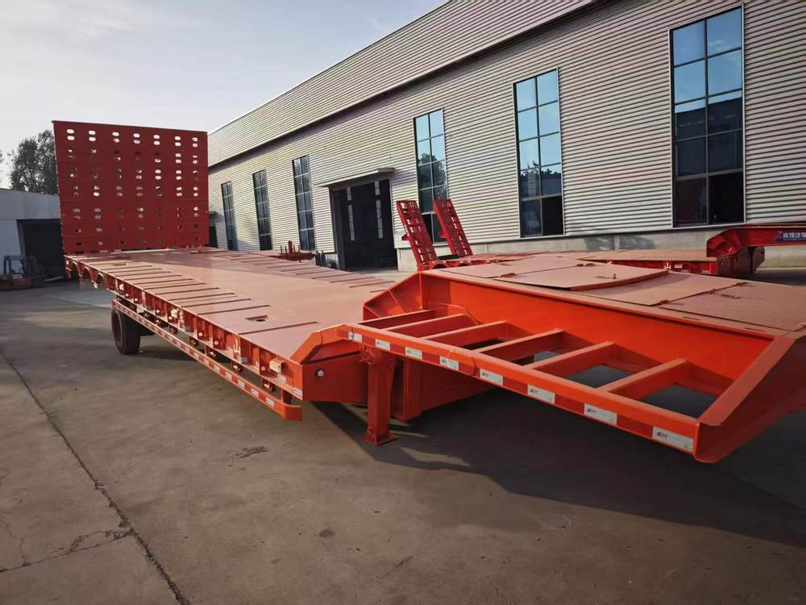
huihuang
09
Gooseneck Lowbed Trailer
Specification | Details
payload | 60 t
dimensions | 15,800 × 3,000 × 2,200 mm
axle arrangement | 3 axles
Suspension | Heavy-duty mechanical suspension
Electrical system | 24 V, LED lights
Main beam material | Q345B steel
The photograph shows a supplied trailer. The table gives a reference configuration for selection.
Final specifications depend on the selected configuration and order confirmation.
Notes:
Company identity, establishment date and business scope: supplied business licence. Photographs: customer materials supplied 8–9 October 2026. White vehicle configuration: customer technical sheet, confirmed by the user to correspond to the white vehicle. Other model specifications: user-authorized reference configurations retained in the website data, sourced from https://www.yuhangauto.com/product/60-ton-lowbed-trailer-for-sale/ , https://www.yuhangauto.com/product/60t-rgn-lowboy-trailer-for-sale/ and https://www.yuhangauto.com/product/4-axle-detachable-lowboy-trailer-for-sale/ . Reference corporate brochure: Laizhou Shancha Machinery company PDF, used for section coverage only. No certifications, production volumes, export history, client cases or service guarantees from that company are attributed to huihuang.

Slide 10
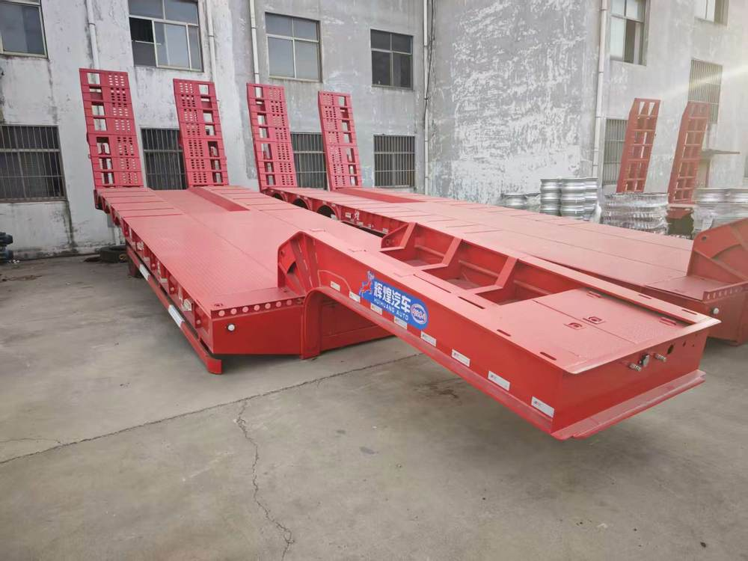
huihuang
10
Heavy-duty Lowbed Trailer
Specification | Details
payload | 100 t
dimensions | 17,000 × 3,500 × 2,500 mm
axle arrangement | 4 axles
tyre specification | 16 × 12R22.5
Suspension | Mechanical suspension
Toolbox | 1 set
The photograph shows a supplied trailer. The table gives a reference configuration for selection.
Final specifications depend on the selected configuration and order confirmation.
Notes:
Company identity, establishment date and business scope: supplied business licence. Photographs: customer materials supplied 8–9 October 2026. White vehicle configuration: customer technical sheet, confirmed by the user to correspond to the white vehicle. Other model specifications: user-authorized reference configurations retained in the website data, sourced from https://www.yuhangauto.com/product/60-ton-lowbed-trailer-for-sale/ , https://www.yuhangauto.com/product/60t-rgn-lowboy-trailer-for-sale/ and https://www.yuhangauto.com/product/4-axle-detachable-lowboy-trailer-for-sale/ . Reference corporate brochure: Laizhou Shancha Machinery company PDF, used for section coverage only. No certifications, production volumes, export history, client cases or service guarantees from that company are attributed to huihuang.

Slide 11
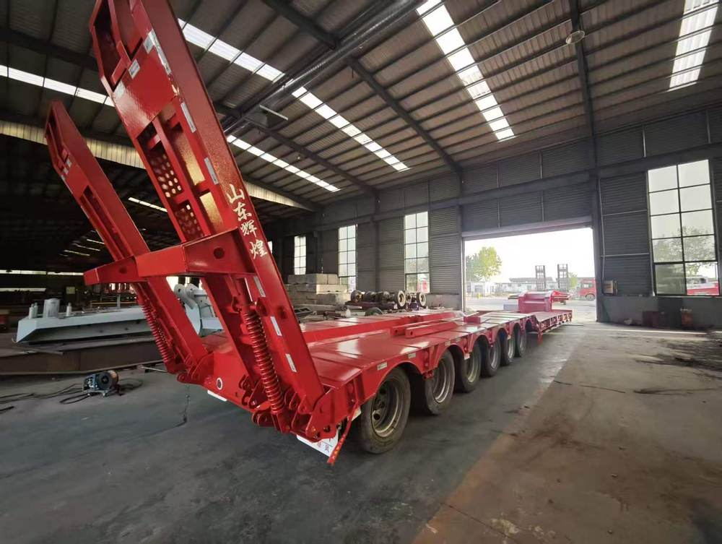
huihuang
11
Multi-axle Lowbed Trailer
Specification | Details
Trailer type | Multi-axle lowbed
Payload | Confirm with our team
Deck dimensions | Confirm with our team
Axle arrangement | Confirm with our team
Provide the equipment weight, dimensions and loading method to discuss the required configuration.
Final specifications depend on the selected configuration and order confirmation.
Notes:
Company identity, establishment date and business scope: supplied business licence. Photographs: customer materials supplied 8–9 October 2026. White vehicle configuration: customer technical sheet, confirmed by the user to correspond to the white vehicle. Other model specifications: user-authorized reference configurations retained in the website data, sourced from https://www.yuhangauto.com/product/60-ton-lowbed-trailer-for-sale/ , https://www.yuhangauto.com/product/60t-rgn-lowboy-trailer-for-sale/ and https://www.yuhangauto.com/product/4-axle-detachable-lowboy-trailer-for-sale/ . Reference corporate brochure: Laizhou Shancha Machinery company PDF, used for section coverage only. No certifications, production volumes, export history, client cases or service guarantees from that company are attributed to huihuang.

Slide 12
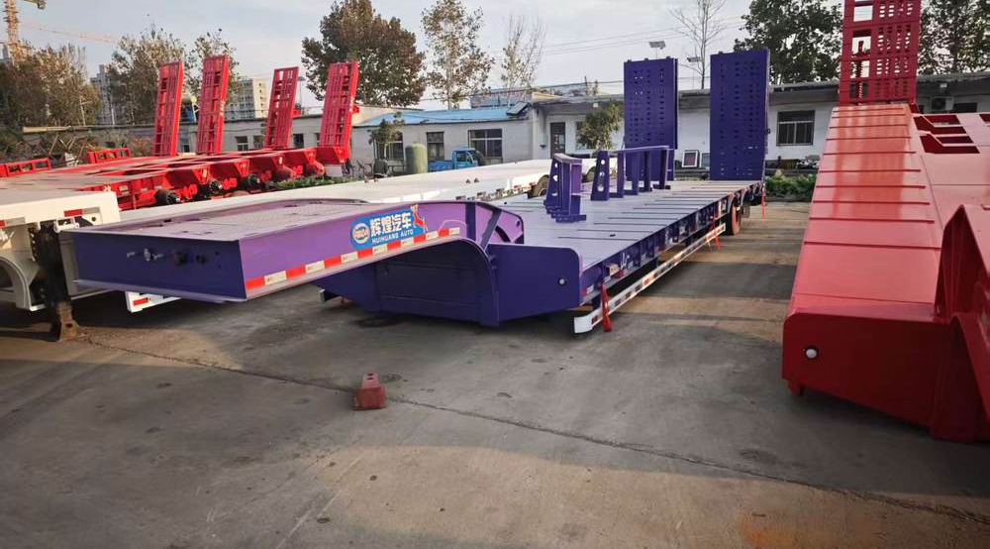
huihuang
12
Trailer photographs
Compare the vehicle layout
Different trailer layouts and finishes appear in the supplied photographs.
Confirm each vehicle’s dimensions, payload and loading method with huihuang.
Notes:
Company identity, establishment date and business scope: supplied business licence. Photographs: customer materials supplied 8–9 October 2026. White vehicle configuration: customer technical sheet, confirmed by the user to correspond to the white vehicle. Other model specifications: user-authorized reference configurations retained in the website data, sourced from https://www.yuhangauto.com/product/60-ton-lowbed-trailer-for-sale/ , https://www.yuhangauto.com/product/60t-rgn-lowboy-trailer-for-sale/ and https://www.yuhangauto.com/product/4-axle-detachable-lowboy-trailer-for-sale/ . Reference corporate brochure: Laizhou Shancha Machinery company PDF, used for section coverage only. No certifications, production volumes, export history, client cases or service guarantees from that company are attributed to huihuang.

Slide 13
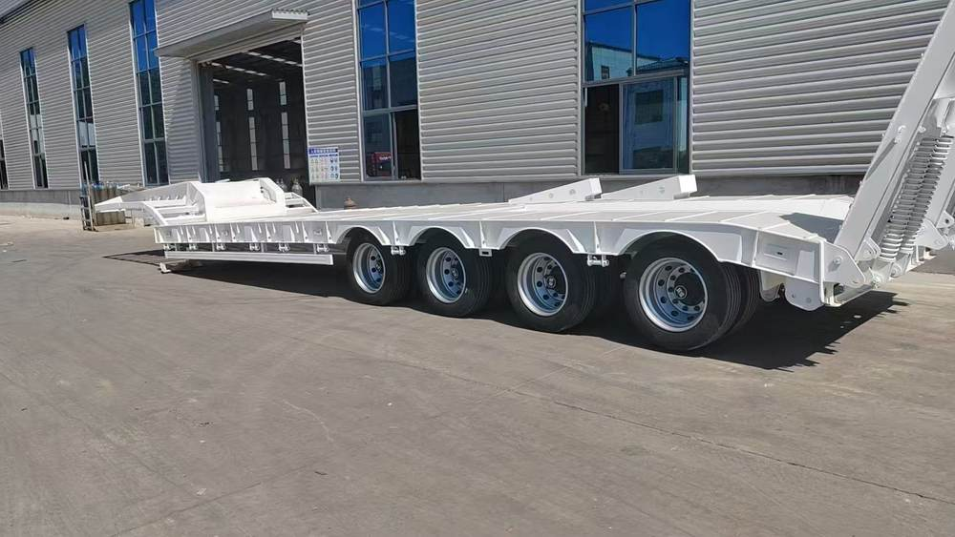
huihuang
13
14 m Four-axle Lowbed Semi-trailer
14 × 3.2 × 3.7 m
Overall dimensions
Four axles and a flat deck
White finish
Notes:
Company identity, establishment date and business scope: supplied business licence. Photographs: customer materials supplied 8–9 October 2026. White vehicle configuration: customer technical sheet, confirmed by the user to correspond to the white vehicle. Other model specifications: user-authorized reference configurations retained in the website data, sourced from https://www.yuhangauto.com/product/60-ton-lowbed-trailer-for-sale/ , https://www.yuhangauto.com/product/60t-rgn-lowboy-trailer-for-sale/ and https://www.yuhangauto.com/product/4-axle-detachable-lowboy-trailer-for-sale/ . Reference corporate brochure: Laizhou Shancha Machinery company PDF, used for section coverage only. No certifications, production volumes, export history, client cases or service guarantees from that company are attributed to huihuang.

Slide 14
huihuang
14
Dimensions and main structure
Specification | Details
Overall dimensions | 14,000 × 3,200 × 3,700 mm
Axles | 4
Colour | White
Main beam height | 520 mm
Upper flange thickness | 16 mm
Lower flange thickness | 20 mm, reinforced below
Web plate thickness | 12 mm
Web plate reinforcement | Reinforced
White trailer details follow the customer-supplied technical specification.
Notes:
Company identity, establishment date and business scope: supplied business licence. Photographs: customer materials supplied 8–9 October 2026. White vehicle configuration: customer technical sheet, confirmed by the user to correspond to the white vehicle. Other model specifications: user-authorized reference configurations retained in the website data, sourced from https://www.yuhangauto.com/product/60-ton-lowbed-trailer-for-sale/ , https://www.yuhangauto.com/product/60t-rgn-lowboy-trailer-for-sale/ and https://www.yuhangauto.com/product/4-axle-detachable-lowboy-trailer-for-sale/ . Reference corporate brochure: Laizhou Shancha Machinery company PDF, used for section coverage only. No certifications, production volumes, export history, client cases or service guarantees from that company are attributed to huihuang.

Slide 15
huihuang
15
Deck and running gear
Specification | Details
Deck construction | High-strength deck with three reinforcing ribs
Deck surface | Flat deck, without a recessed centre
Tyre designation | Weishan 295-60
Tyres | 16
Wheel rims | 16 reinforced factory-supplied rims
Leaf springs | 10 thickened leaves
Suspension | Reinforced suspension
Confirm the payload rating and full tyre designation for the intended order.
Notes:
Company identity, establishment date and business scope: supplied business licence. Photographs: customer materials supplied 8–9 October 2026. White vehicle configuration: customer technical sheet, confirmed by the user to correspond to the white vehicle. Other model specifications: user-authorized reference configurations retained in the website data, sourced from https://www.yuhangauto.com/product/60-ton-lowbed-trailer-for-sale/ , https://www.yuhangauto.com/product/60t-rgn-lowboy-trailer-for-sale/ and https://www.yuhangauto.com/product/4-axle-detachable-lowboy-trailer-for-sale/ . Reference corporate brochure: Laizhou Shancha Machinery company PDF, used for section coverage only. No certifications, production volumes, export history, client cases or service guarantees from that company are attributed to huihuang.

Slide 16
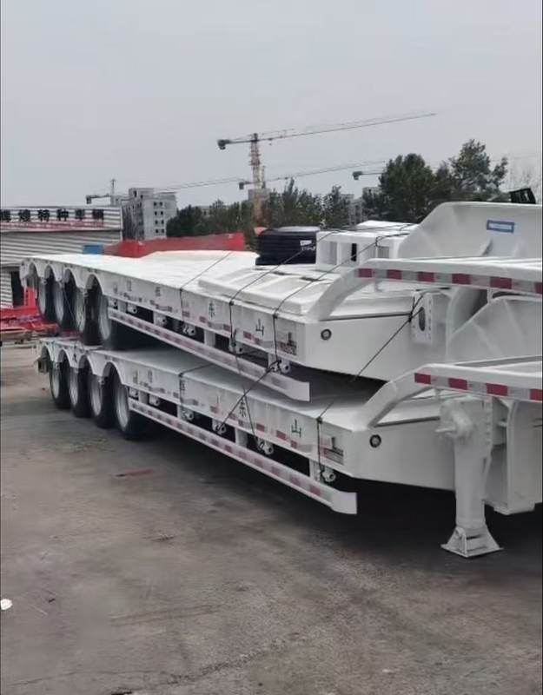
huihuang
16
Loading and auxiliary equipment
Specification | Details
Landing gear | Fuhua, single-action
Loading ramps | Twin wide ramps, 950 mm wide
Rope tensioners | 8 on each side
Straight hooks | Closer spacing and reinforced construction
Brake valve | WABCO
Fuhua landing gear and WABCO brake valve appear in the supplied configuration.
Notes:
Company identity, establishment date and business scope: supplied business licence. Photographs: customer materials supplied 8–9 October 2026. White vehicle configuration: customer technical sheet, confirmed by the user to correspond to the white vehicle. Other model specifications: user-authorized reference configurations retained in the website data, sourced from https://www.yuhangauto.com/product/60-ton-lowbed-trailer-for-sale/ , https://www.yuhangauto.com/product/60t-rgn-lowboy-trailer-for-sale/ and https://www.yuhangauto.com/product/4-axle-detachable-lowboy-trailer-for-sale/ . Reference corporate brochure: Laizhou Shancha Machinery company PDF, used for section coverage only. No certifications, production volumes, export history, client cases or service guarantees from that company are attributed to huihuang.

Slide 17
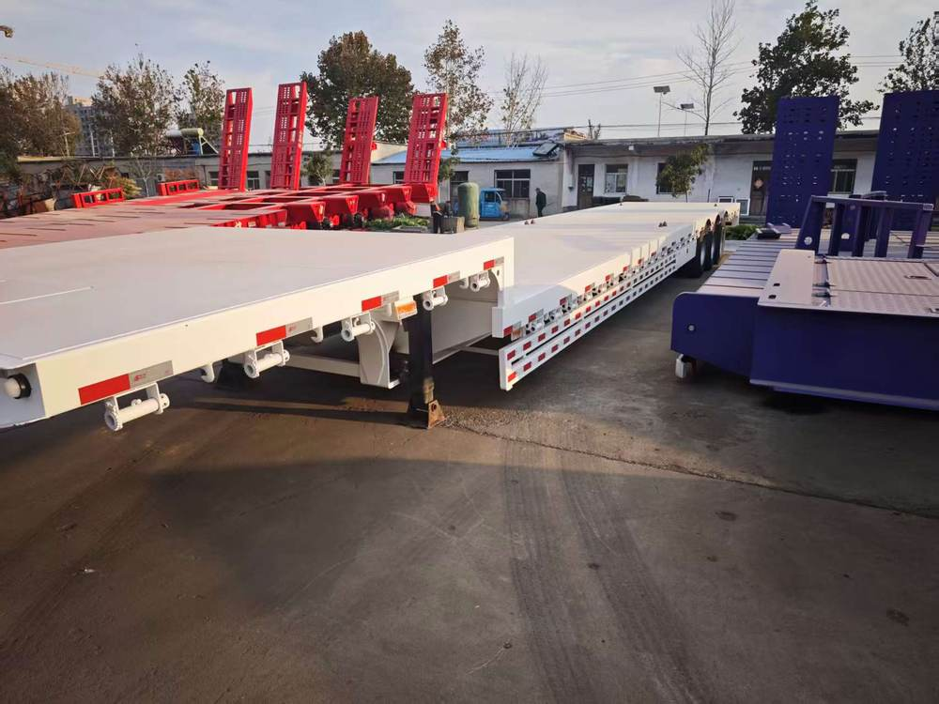
huihuang
17
Main beam and deck selection
Match the structure
to the transport requirement
White trailer: 520 mm main beam, 16 mm upper flange, 20 mm lower flange and 12 mm web plate.
Flat deck, without a recessed centre.
Confirm the beam and deck dimensions for each vehicle.
Notes:
Company identity, establishment date and business scope: supplied business licence. Photographs: customer materials supplied 8–9 October 2026. White vehicle configuration: customer technical sheet, confirmed by the user to correspond to the white vehicle. Other model specifications: user-authorized reference configurations retained in the website data, sourced from https://www.yuhangauto.com/product/60-ton-lowbed-trailer-for-sale/ , https://www.yuhangauto.com/product/60t-rgn-lowboy-trailer-for-sale/ and https://www.yuhangauto.com/product/4-axle-detachable-lowboy-trailer-for-sale/ . Reference corporate brochure: Laizhou Shancha Machinery company PDF, used for section coverage only. No certifications, production volumes, export history, client cases or service guarantees from that company are attributed to huihuang.

Slide 18
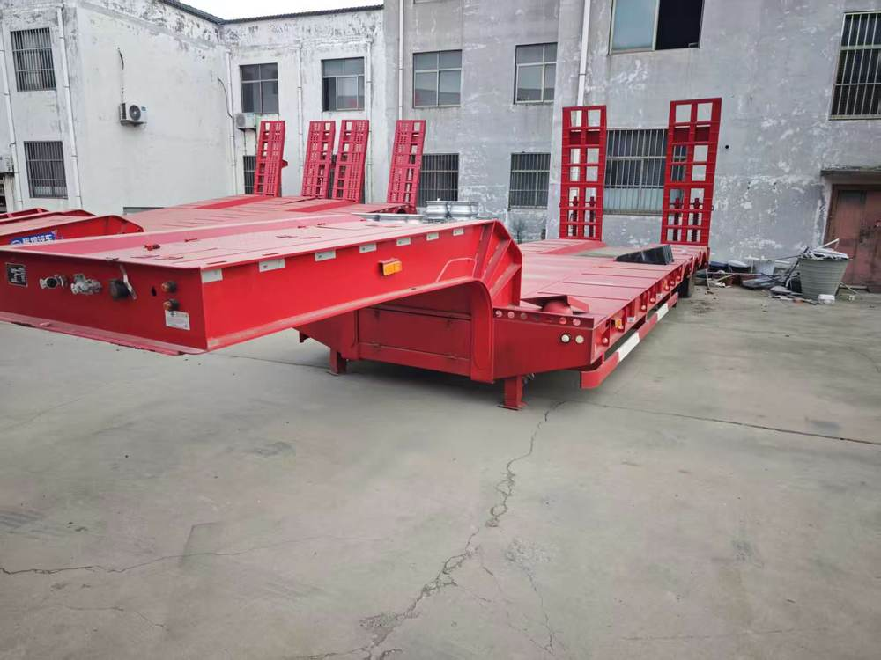
huihuang
18
Loading arrangement
Ramps and
loading clearance
Confirm approach angle, track or wheel width and loading space.
White trailer: twin wide ramps, 950 mm wide.
Confirm ramp size and operation for the selected vehicle.
Notes:
Company identity, establishment date and business scope: supplied business licence. Photographs: customer materials supplied 8–9 October 2026. White vehicle configuration: customer technical sheet, confirmed by the user to correspond to the white vehicle. Other model specifications: user-authorized reference configurations retained in the website data, sourced from https://www.yuhangauto.com/product/60-ton-lowbed-trailer-for-sale/ , https://www.yuhangauto.com/product/60t-rgn-lowboy-trailer-for-sale/ and https://www.yuhangauto.com/product/4-axle-detachable-lowboy-trailer-for-sale/ . Reference corporate brochure: Laizhou Shancha Machinery company PDF, used for section coverage only. No certifications, production volumes, export history, client cases or service guarantees from that company are attributed to huihuang.

Slide 19
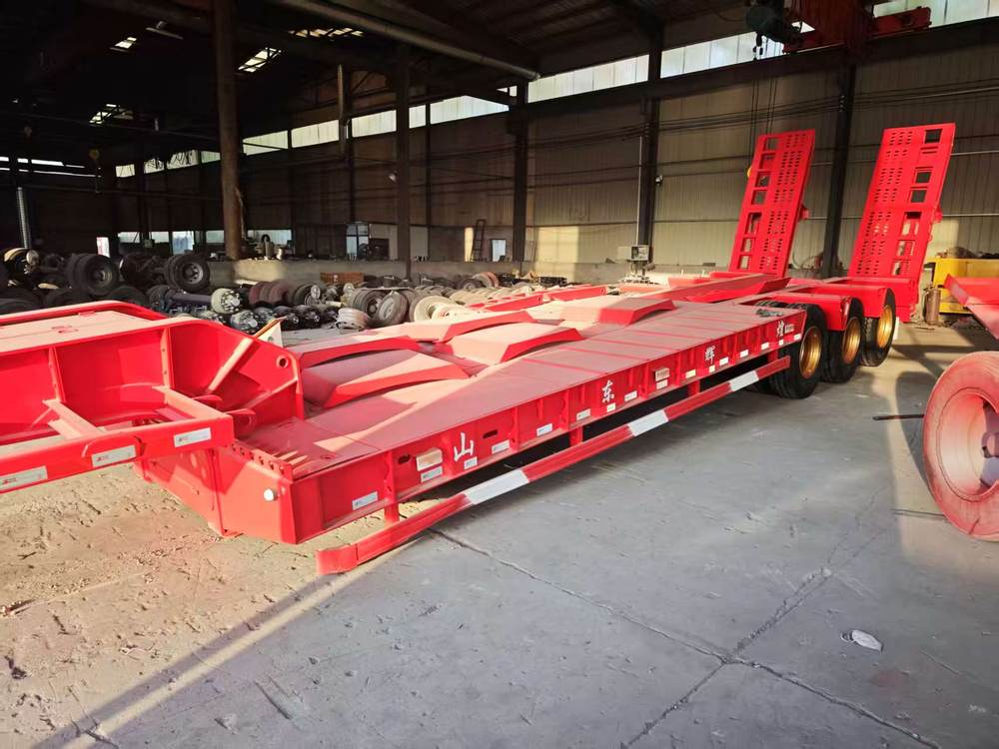
huihuang
19
Configuration items to confirm
Size, structure
and component selection
Overall size and usable deck space
Axles, suspension, tyres and leaf springs
Landing gear and loading ramps
Brakes, lights and wheel rims
Agree the configuration in writing before ordering.
Notes:
Company identity, establishment date and business scope: supplied business licence. Photographs: customer materials supplied 8–9 October 2026. White vehicle configuration: customer technical sheet, confirmed by the user to correspond to the white vehicle. Other model specifications: user-authorized reference configurations retained in the website data, sourced from https://www.yuhangauto.com/product/60-ton-lowbed-trailer-for-sale/ , https://www.yuhangauto.com/product/60t-rgn-lowboy-trailer-for-sale/ and https://www.yuhangauto.com/product/4-axle-detachable-lowboy-trailer-for-sale/ . Reference corporate brochure: Laizhou Shancha Machinery company PDF, used for section coverage only. No certifications, production volumes, export history, client cases or service guarantees from that company are attributed to huihuang.

Slide 20
huihuang
20
Information for a quotation
Item | Information to provide
Transported machinery | Equipment type, model and photographs
Load and dimensions | Equipment weight, length, width and height
Loading method | How the equipment enters and leaves the trailer
Operating conditions | Destination, route constraints and local requirements
Required configuration | Axles, deck, ramps and preferred components
Order details | Quantity, delivery destination and requested schedule
Local compliance, shipping arrangements and delivery terms need individual confirmation.
Notes:
Company identity, establishment date and business scope: supplied business licence. Photographs: customer materials supplied 8–9 October 2026. White vehicle configuration: customer technical sheet, confirmed by the user to correspond to the white vehicle. Other model specifications: user-authorized reference configurations retained in the website data, sourced from https://www.yuhangauto.com/product/60-ton-lowbed-trailer-for-sale/ , https://www.yuhangauto.com/product/60t-rgn-lowboy-trailer-for-sale/ and https://www.yuhangauto.com/product/4-axle-detachable-lowboy-trailer-for-sale/ . Reference corporate brochure: Laizhou Shancha Machinery company PDF, used for section coverage only. No certifications, production volumes, export history, client cases or service guarantees from that company are attributed to huihuang.

Slide 21
huihuang
21
Order and service discussion
Configuration confirmation
Agree the vehicle dimensions, load requirement and component list. Use the confirmed specification for the quotation.
Delivery and commercial terms
Confirm the quantity, delivery destination, payment terms and schedule with huihuang for the specific order.
Service and maintenance
Discuss warranty terms, operating guidance, maintenance documents and parts requirements before order confirmation.
Notes:
Company identity, establishment date and business scope: supplied business licence. Photographs: customer materials supplied 8–9 October 2026. White vehicle configuration: customer technical sheet, confirmed by the user to correspond to the white vehicle. Other model specifications: user-authorized reference configurations retained in the website data, sourced from https://www.yuhangauto.com/product/60-ton-lowbed-trailer-for-sale/ , https://www.yuhangauto.com/product/60t-rgn-lowboy-trailer-for-sale/ and https://www.yuhangauto.com/product/4-axle-detachable-lowboy-trailer-for-sale/ . Reference corporate brochure: Laizhou Shancha Machinery company PDF, used for section coverage only. No certifications, production volumes, export history, client cases or service guarantees from that company are attributed to huihuang.

Slide 22
huihuang
22
Contact huihuang
Semi-trailers and special vehicles
+86 13684939429
gaoyangy14@gmail.com
WhatsApp +9875852376888
huihuang.yunwu.asia
Liangshan County Industrial Park
Jining, Shandong, China
Notes:
Company identity, establishment date and business scope: supplied business licence. Photographs: customer materials supplied 8–9 October 2026. White vehicle configuration: customer technical sheet, confirmed by the user to correspond to the white vehicle. Other model specifications: user-authorized reference configurations retained in the website data, sourced from https://www.yuhangauto.com/product/60-ton-lowbed-trailer-for-sale/ , https://www.yuhangauto.com/product/60t-rgn-lowboy-trailer-for-sale/ and https://www.yuhangauto.com/product/4-axle-detachable-lowboy-trailer-for-sale/ . Reference corporate brochure: Laizhou Shancha Machinery company PDF, used for section coverage only. No certifications, production volumes, export history, client cases or service guarantees from that company are attributed to huihuang.

